Slide 1

Social Listening of Beachbody’s
Twitter and Facebook

Slide 2
POST
Purpose
Present findings on Beachbody’s social listening
Present Technical Solution
Find the top 25 most common hashtags associated with Beachbody over the course of 1 week
Visualize the top 25 as a histogram to show the distribution of each
Provide initial ideas on how to use Social Listening to improve customer satisfaction and business overall
Provide initial ideas on how Data Sciences could be used at Beachbody
Outcome
Definition of next steps
Structure
Presentation and potential visualization on separate platform
Code Review
Q&A
Time
60 minutes including Q&A

Slide 3
Technical Solution

Slide 4
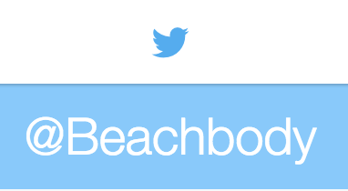
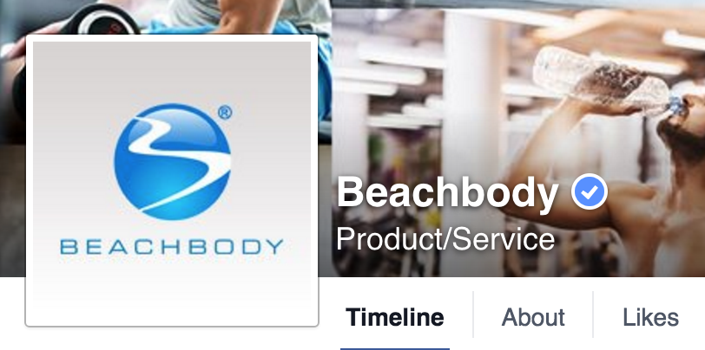




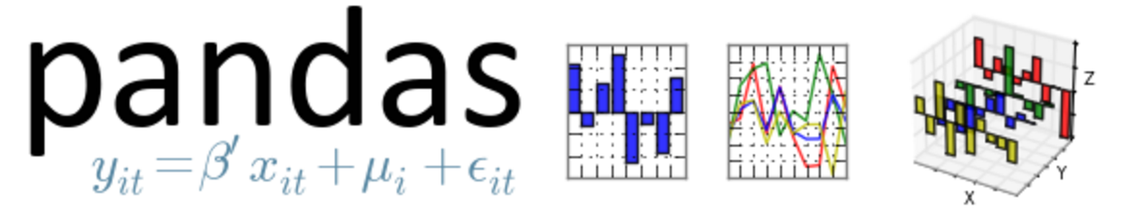




Technical Architecture - Layers
Source
Data Extraction (APIs)
Data “Transformation” and Storage
Analysis and Presentation
Sentiment
Analysis
Graphics
Geo-referential
Graphs

Slide 5
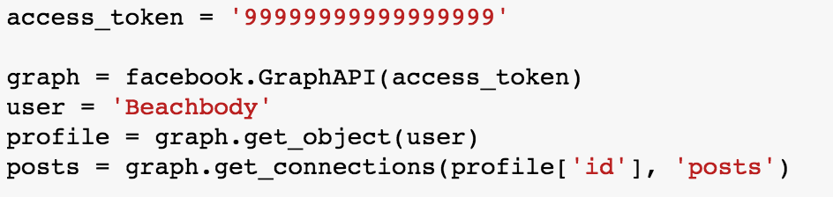
How was the data extraction done?
Examples of APIs used:
API
Response
API
Calls
https://api.twitter.com/1.1/search/tweets.json?src=typd&q=%40Beachbody
https://api.twitter.com/1.1/users/search.json?q=(name of user)
Python Program
Public Twitter API

Slide 6
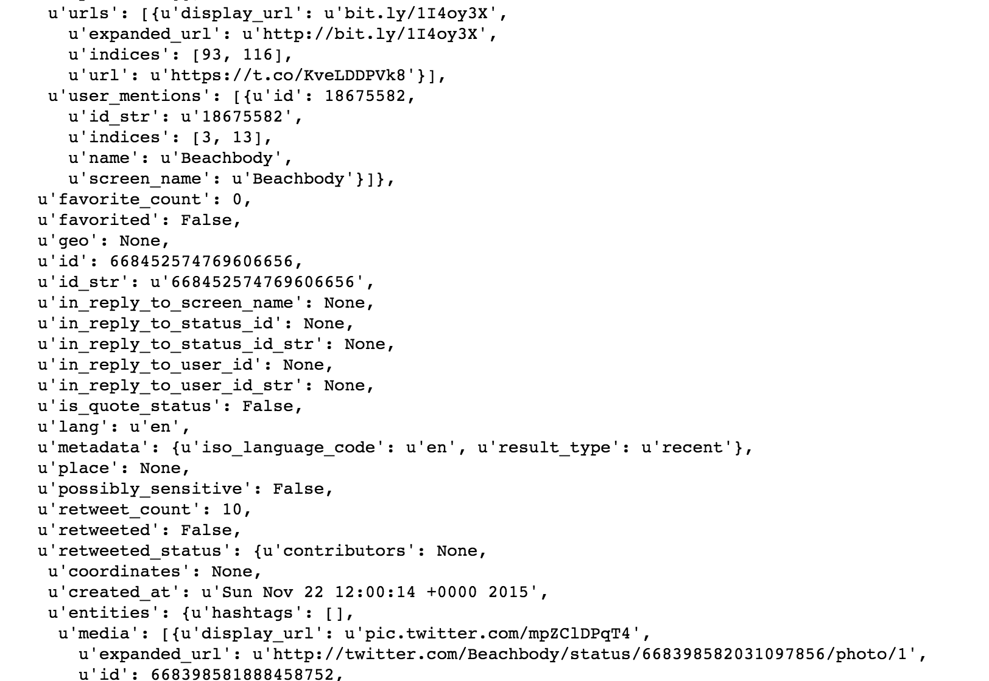
How was the data extraction done?
Examples of API response :
API
Response
API
Calls
Python Program
Response Parsing

Slide 7

Source Code (examples)
Martin’s Repository

Slide 8
Social Listening

Slide 9
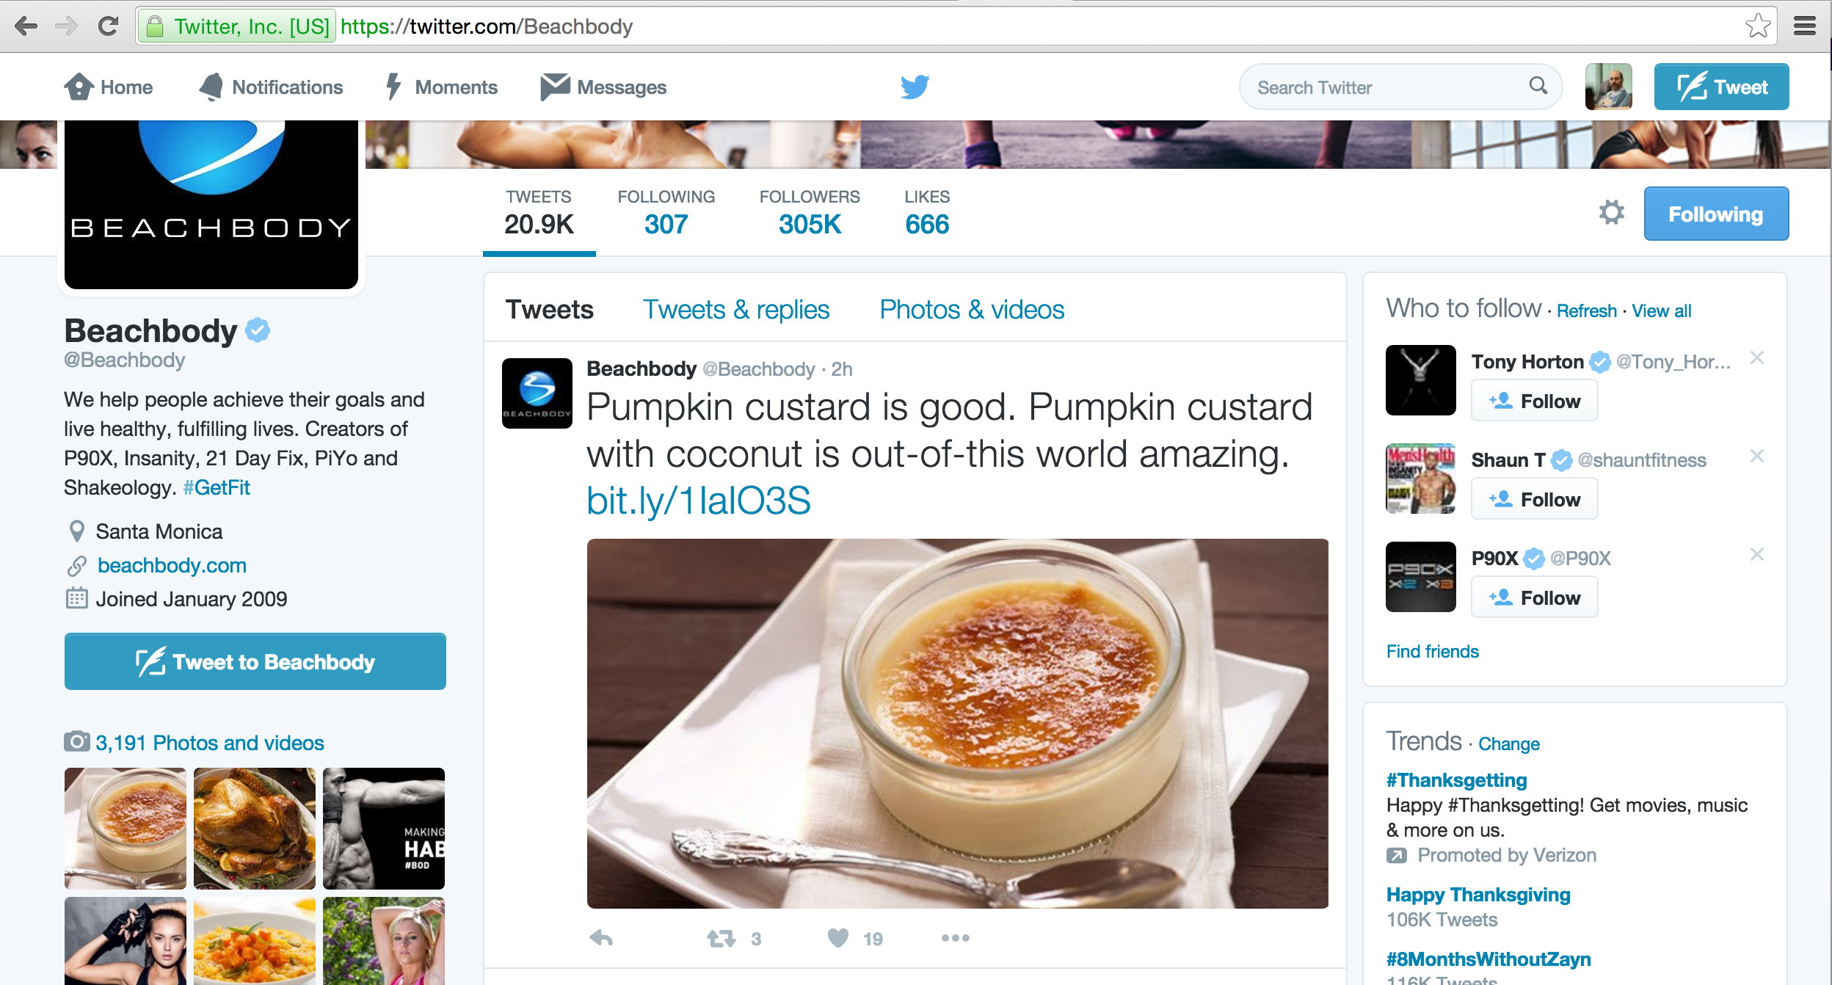
Top 25 most common hashtags associated with Beachbody over the course of 1 week
Week from 11/13 to 11/24
@Beachbody was mentioned in 1,400 tweets
371 Original Tweets
1029 Re-tweets

Slide 10
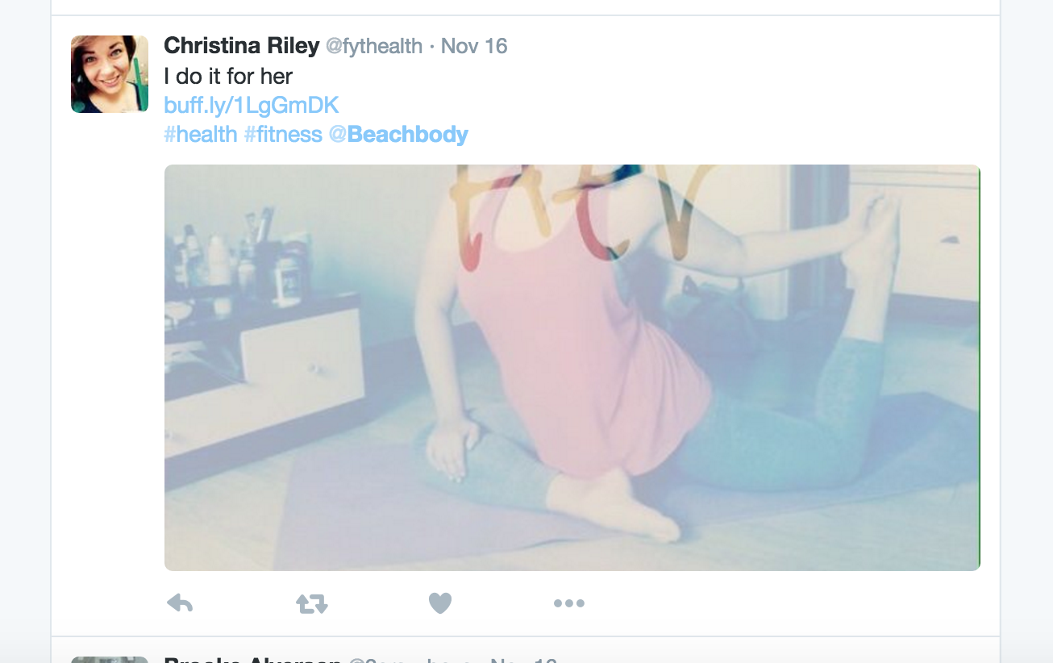
Twitter Listening What is what in Twitter’s World
User @Beachbody mentioned on the Tweet
Hashtags
Retweeted

Slide 11
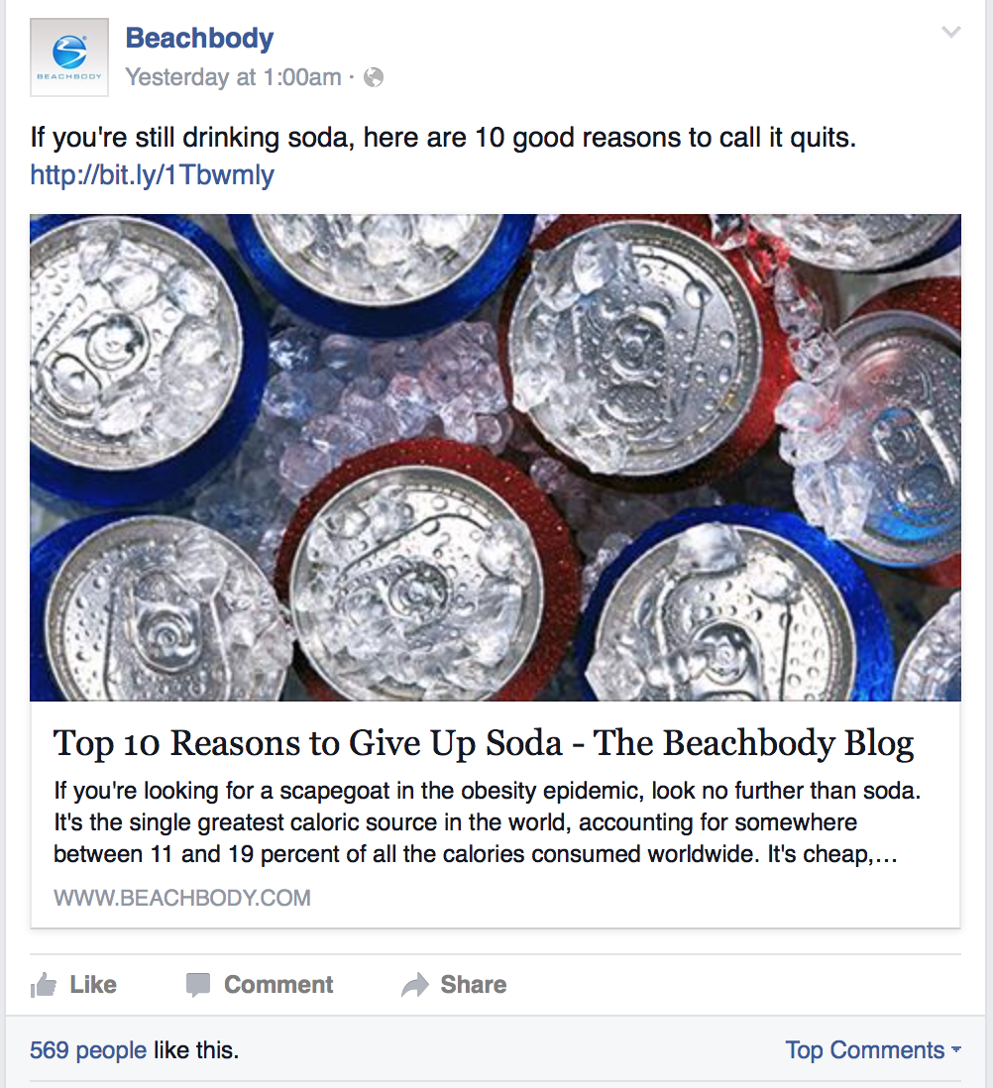
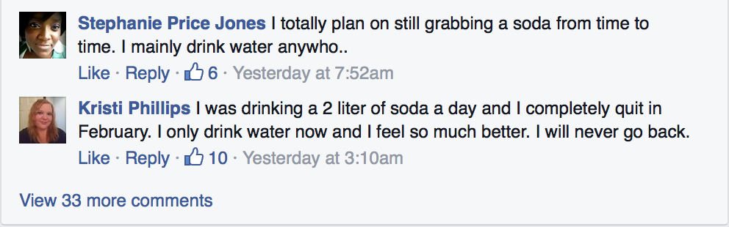
Facebook Listening What is what in FB’s World
Beachbody Facebook Page
Follower’s comments

Slide 12
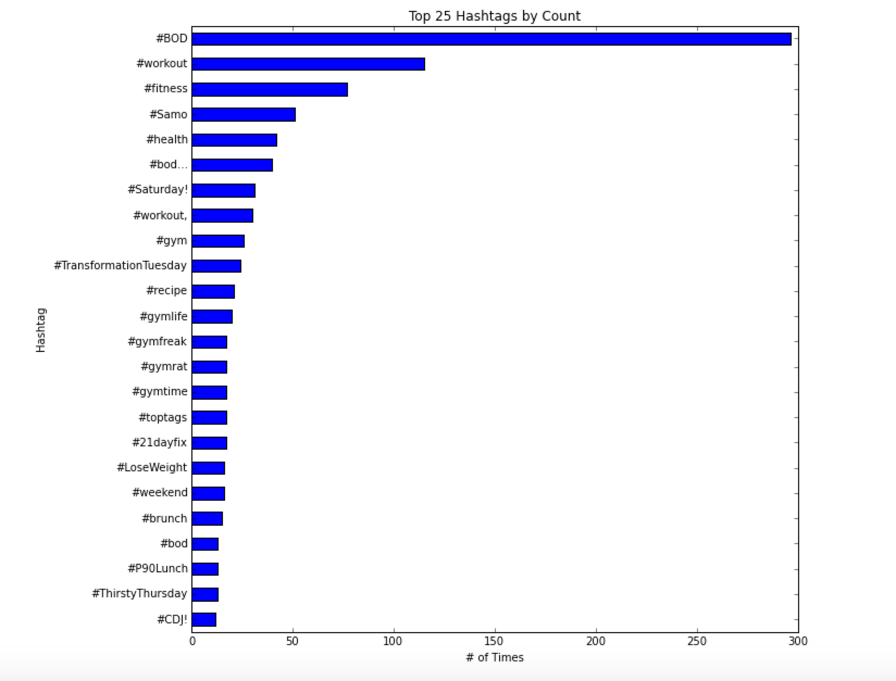
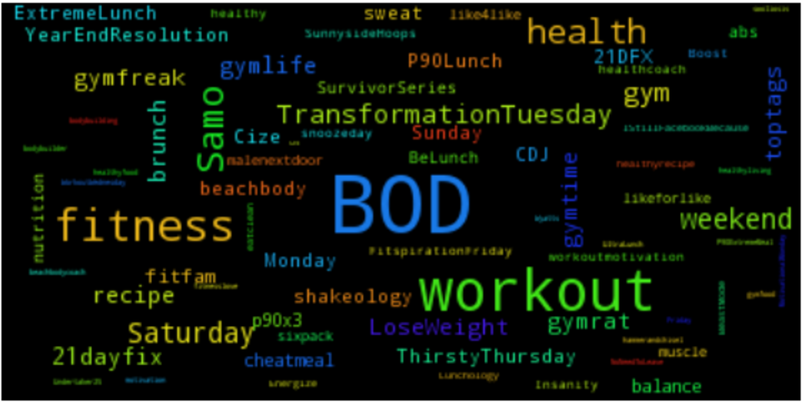
Top 25 most common hashtags associated with Beachbody over the course of 1 week
from 11/13 to 11/24
@Beachbody was mentioned in 1,400 tweets
371 Original Tweets
1029 Re-tweets

Slide 13
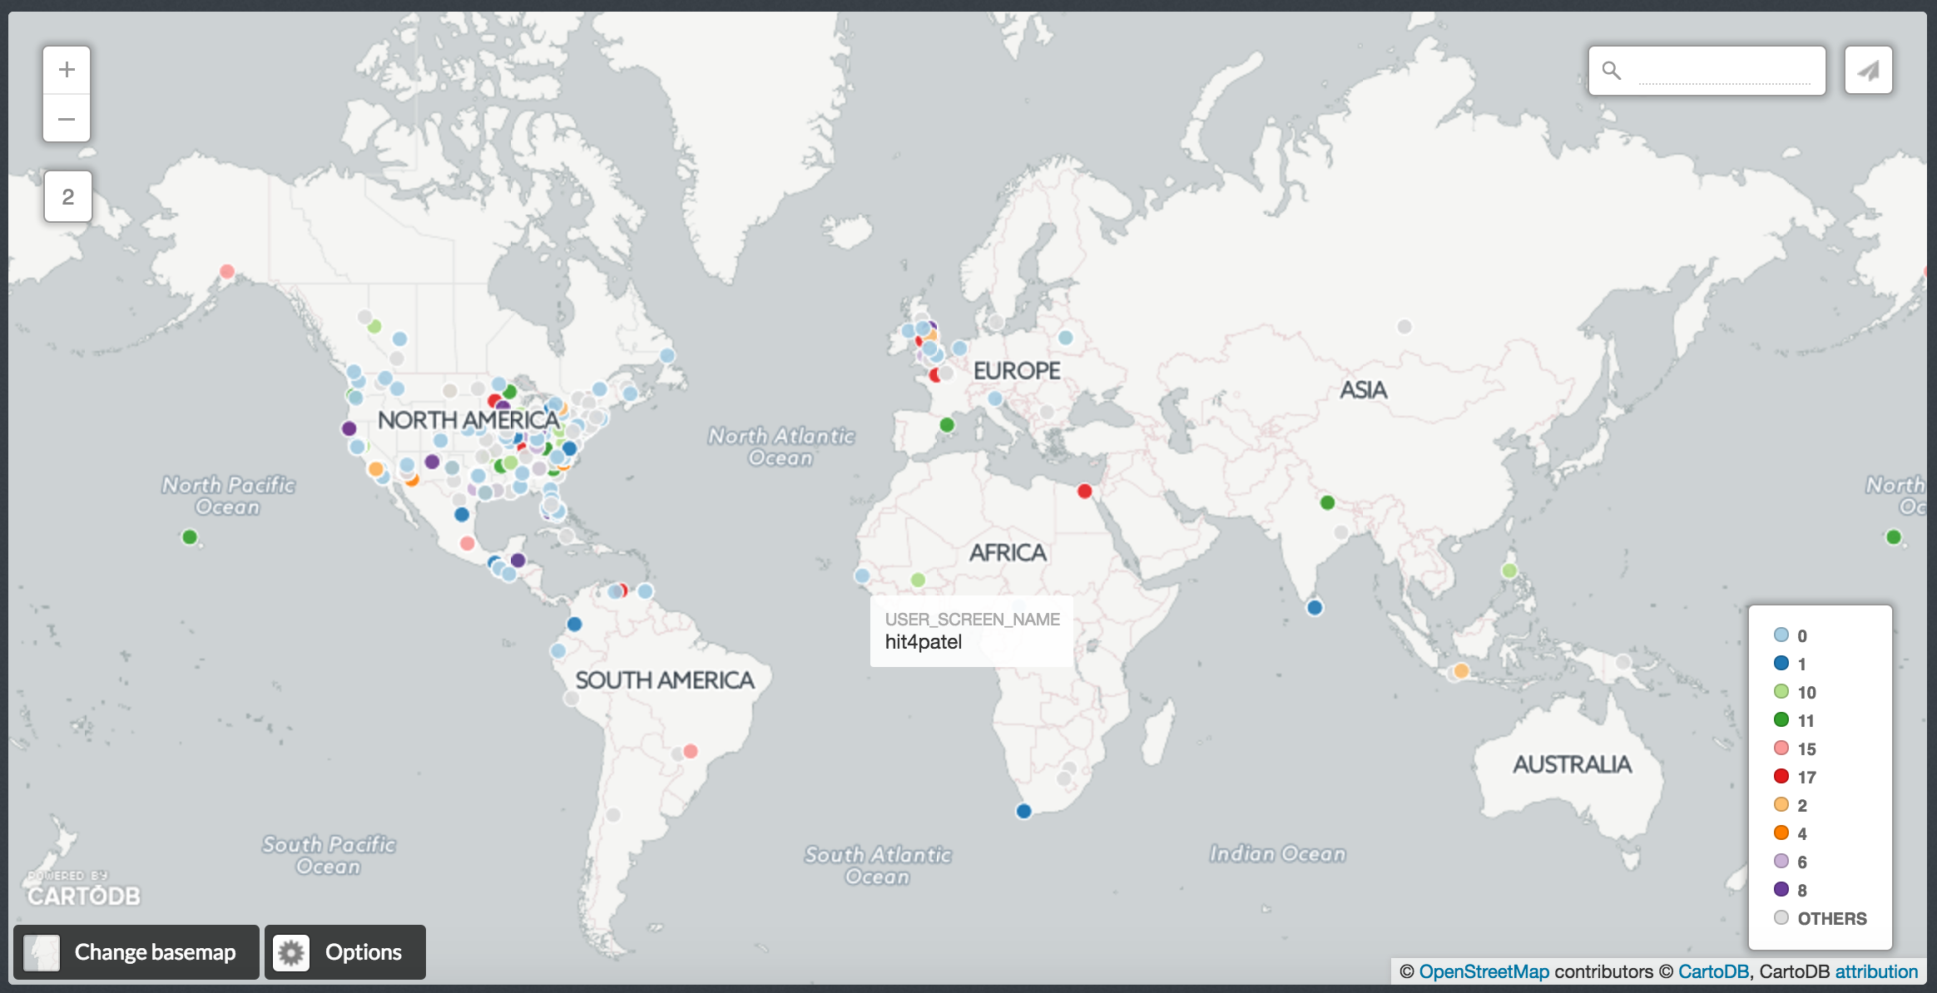
User Geographies Dot colors represent # of times twitted or re-tweeted
CartoDB
Note: these represent users that either twitted or re-twitted during this time-frame

Slide 14
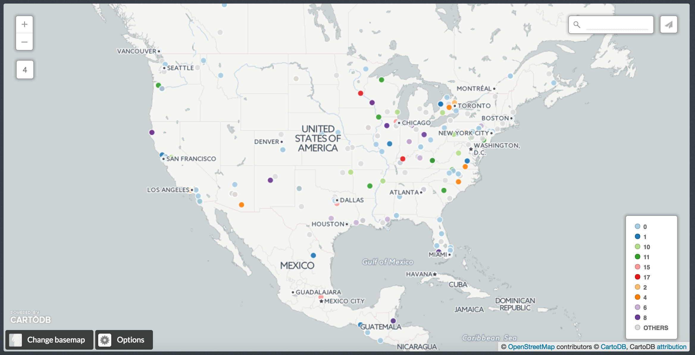
User Geographies - USA
CartoDB
Note: these represent users that either twitted or re-twitted during this time-frame

Slide 15
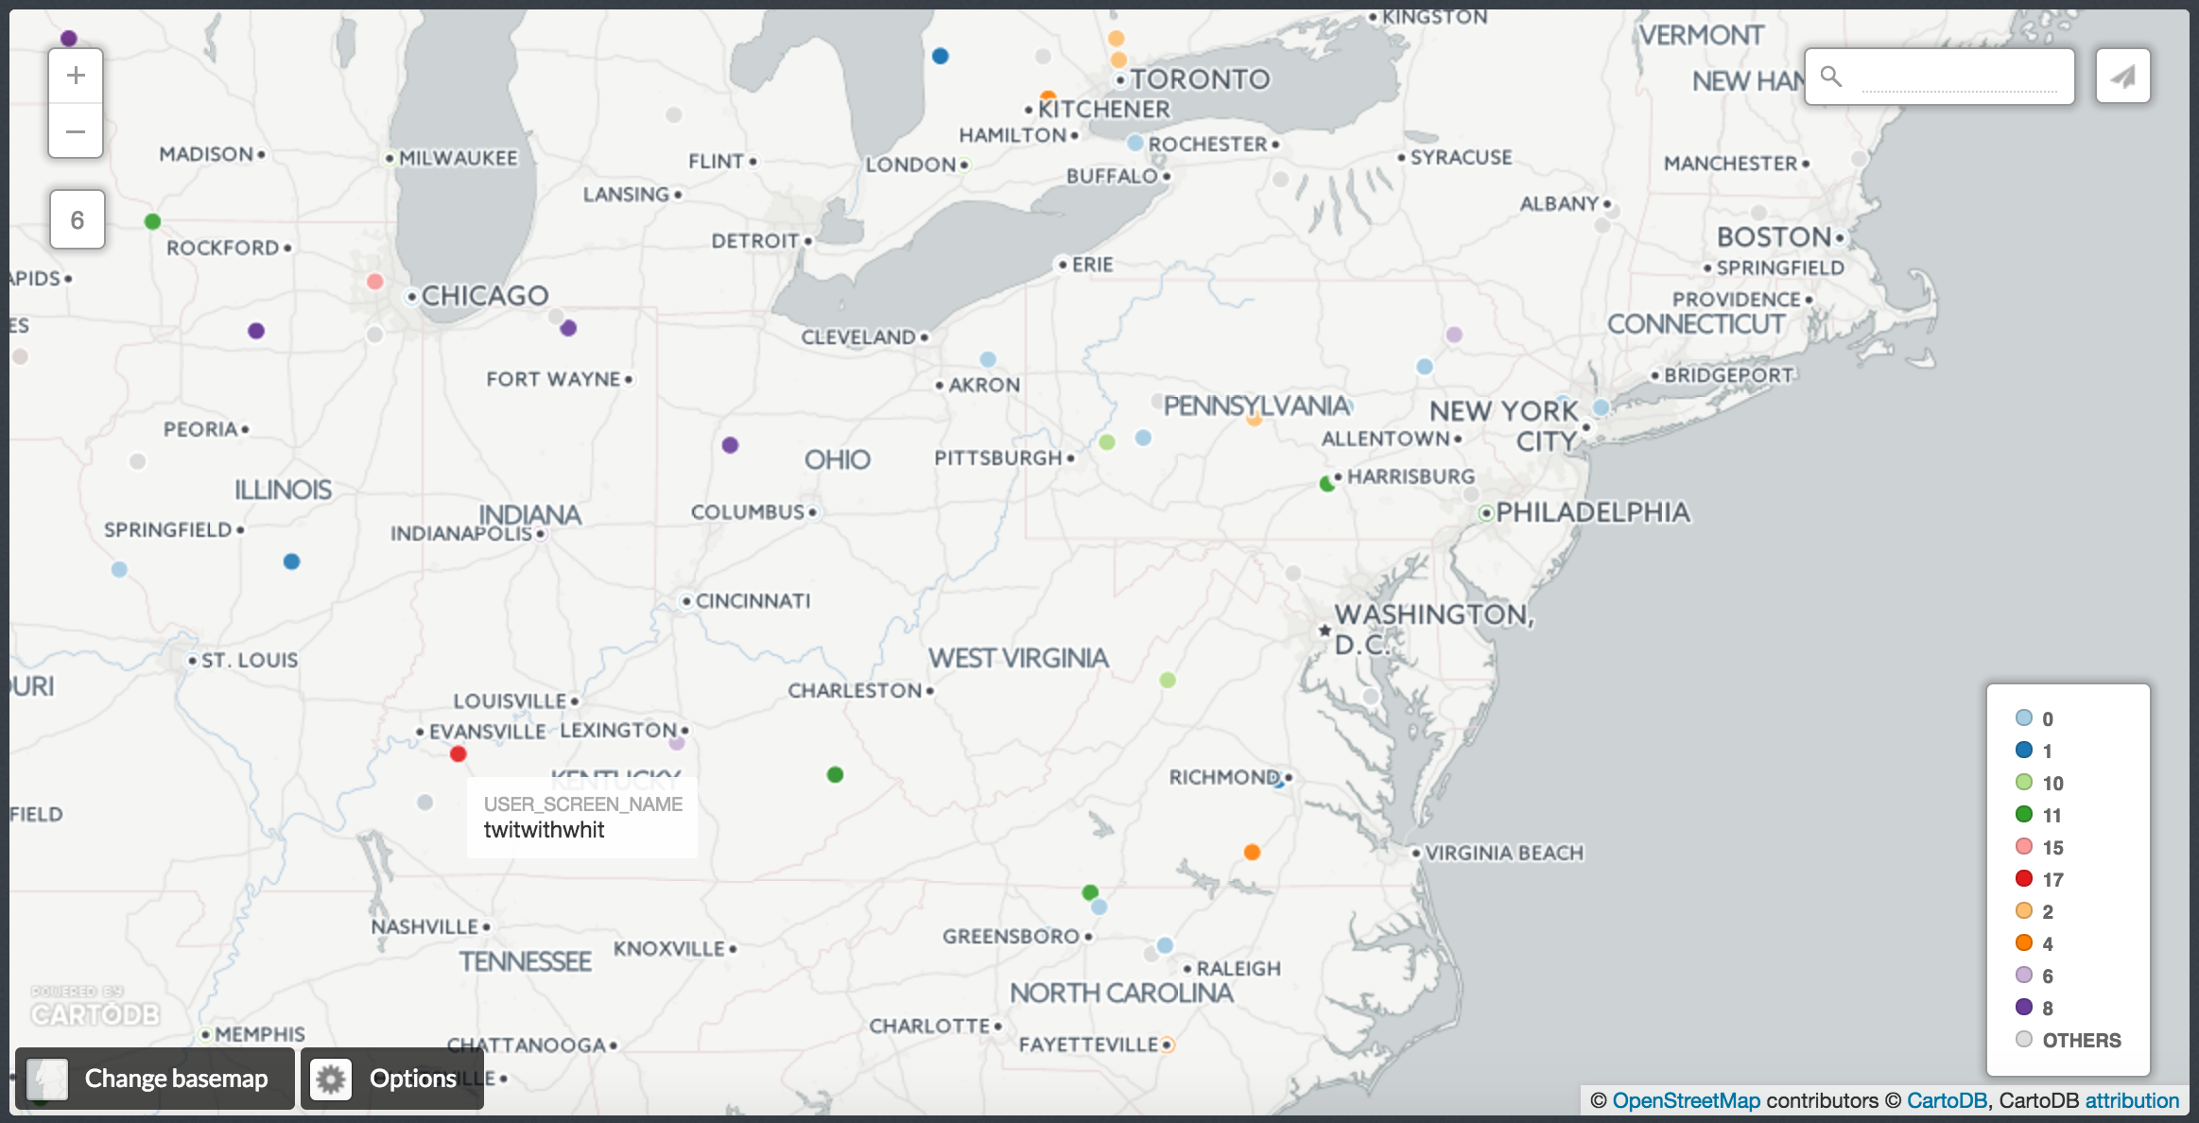
User Geographies – USA Region
CartoDB
Note: these represent users that either twitted or re-twitted during this time-frame

Slide 16
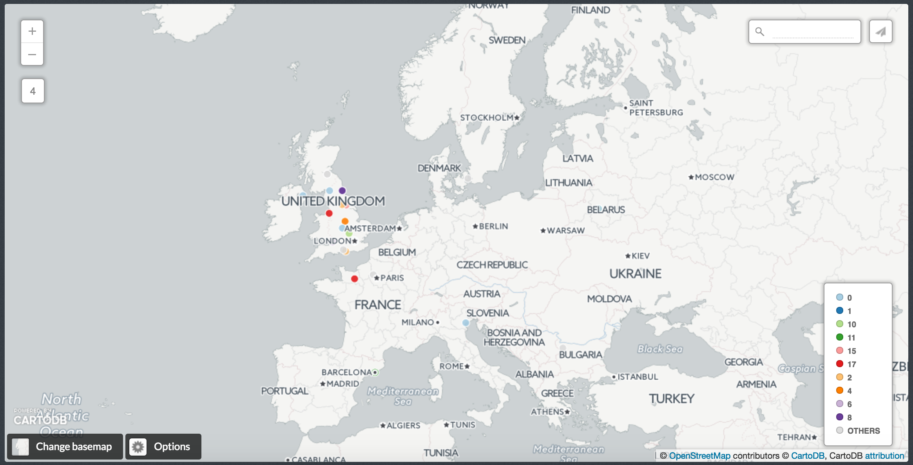
Europe
CartoDB
Note: these represent users that either twitted or re-twitted during this time-frame

Slide 17
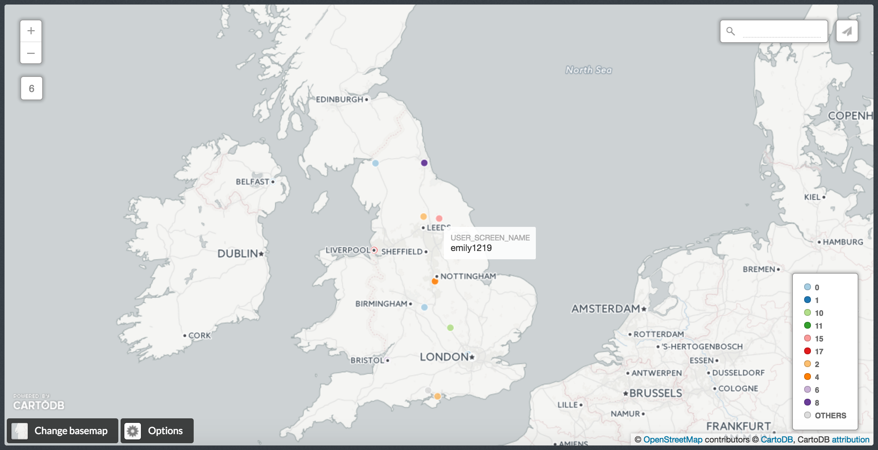
Europe - UK
CartoDB
Note: these represent users that either twitted or re-twitted during this time-frame

Slide 18
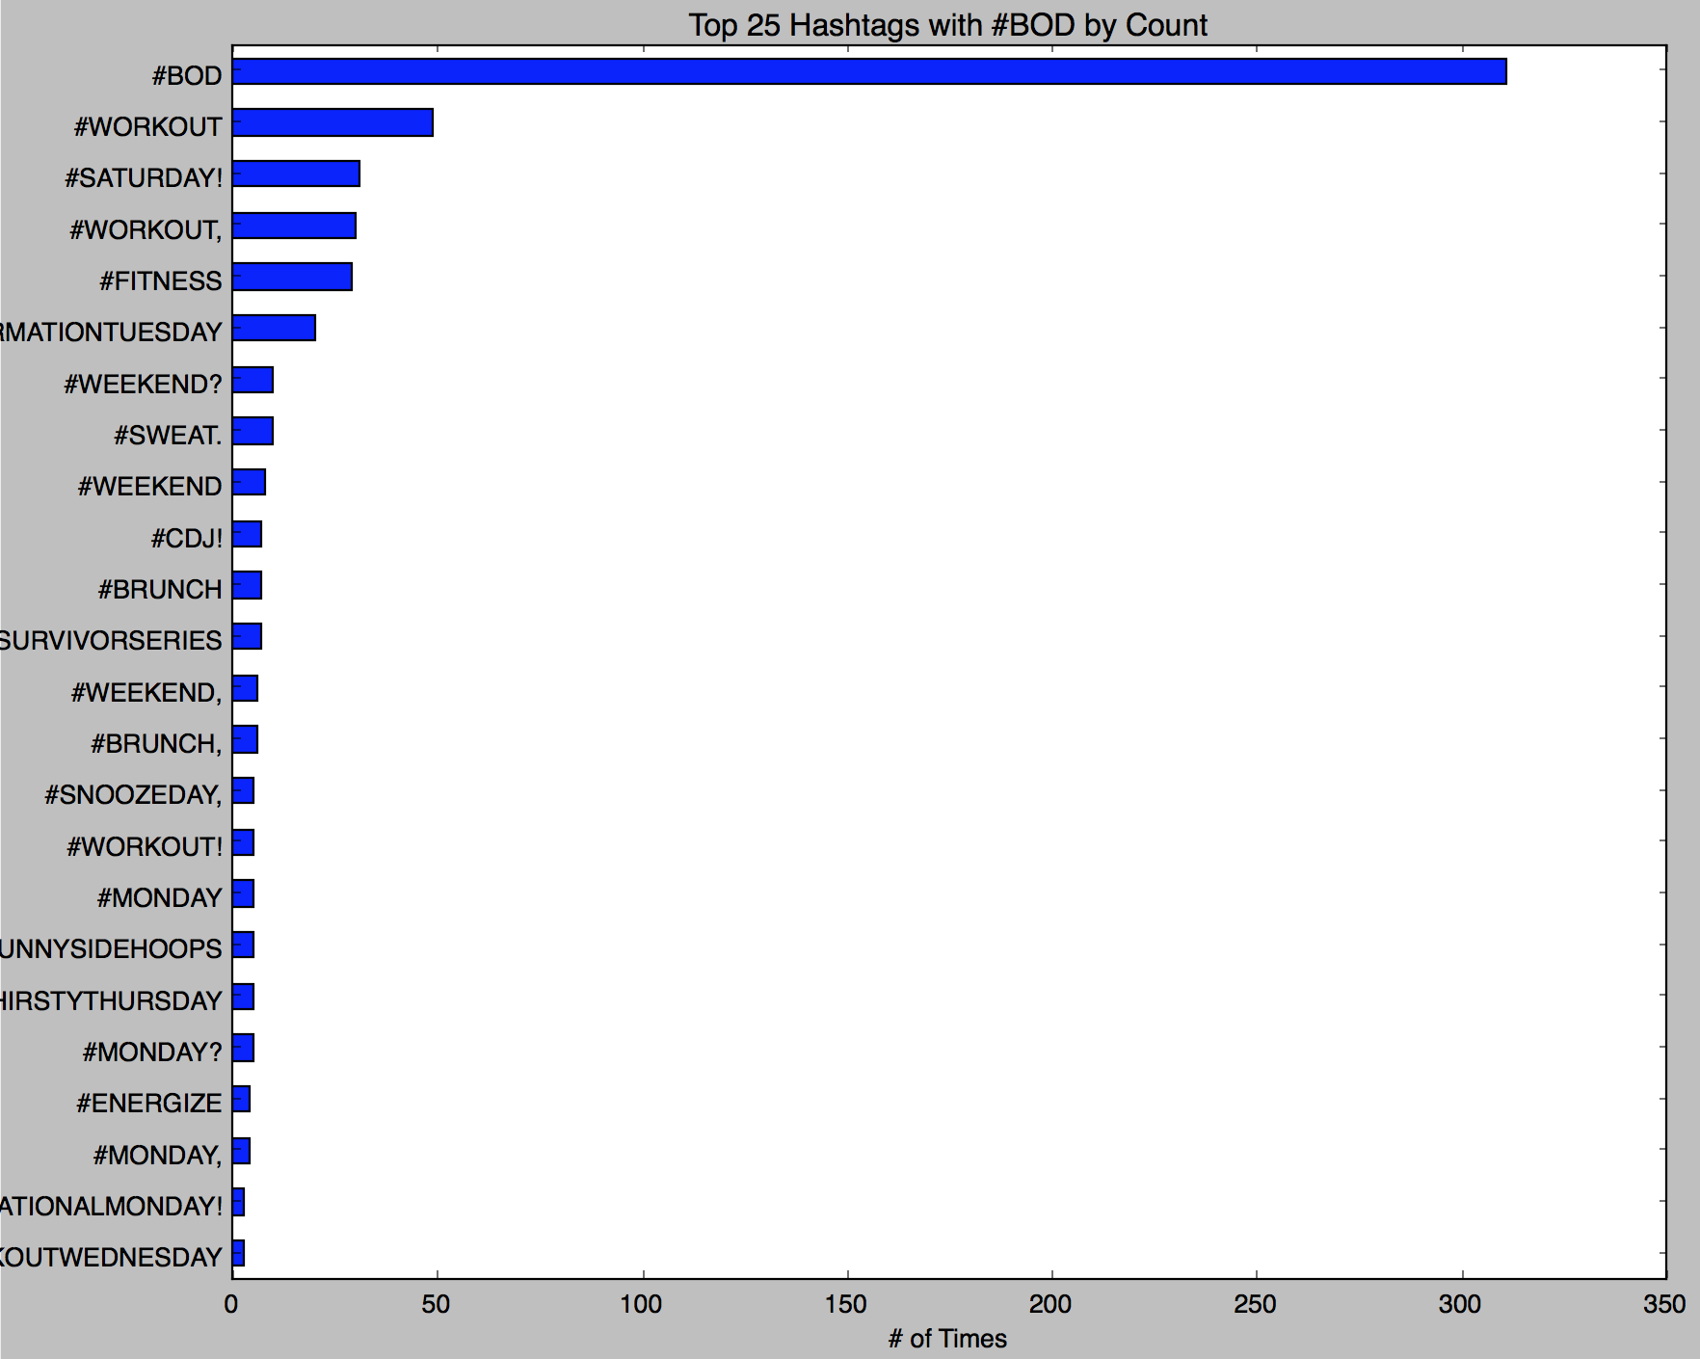
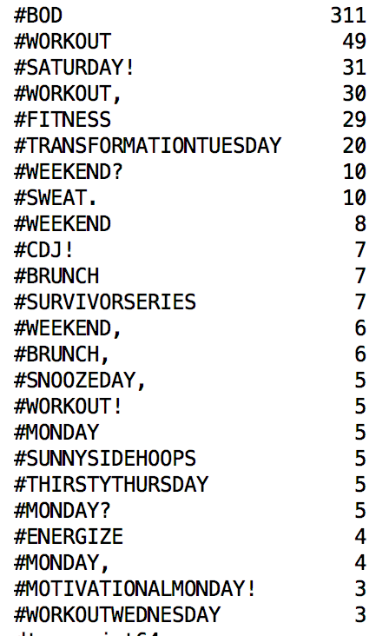
Top 25 most common hashtags associated with Beachbody and #BOD

Slide 19
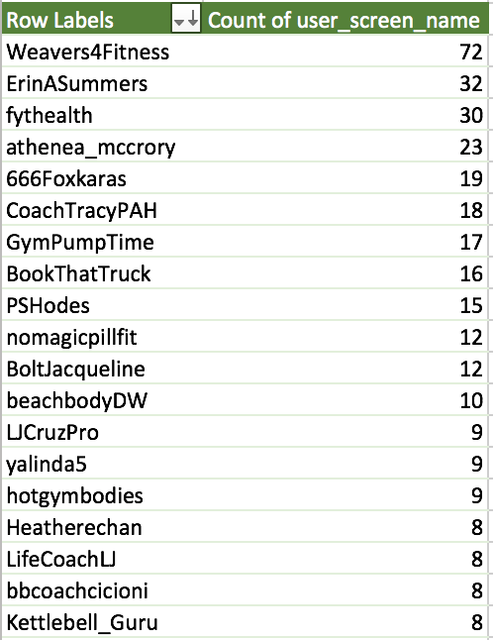
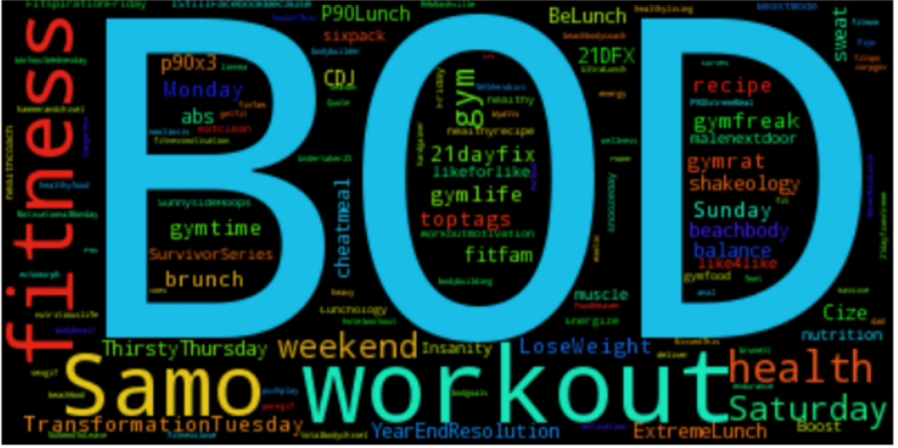
Most active users (re-tweeted @Beachbody’s tweet)

Slide 20
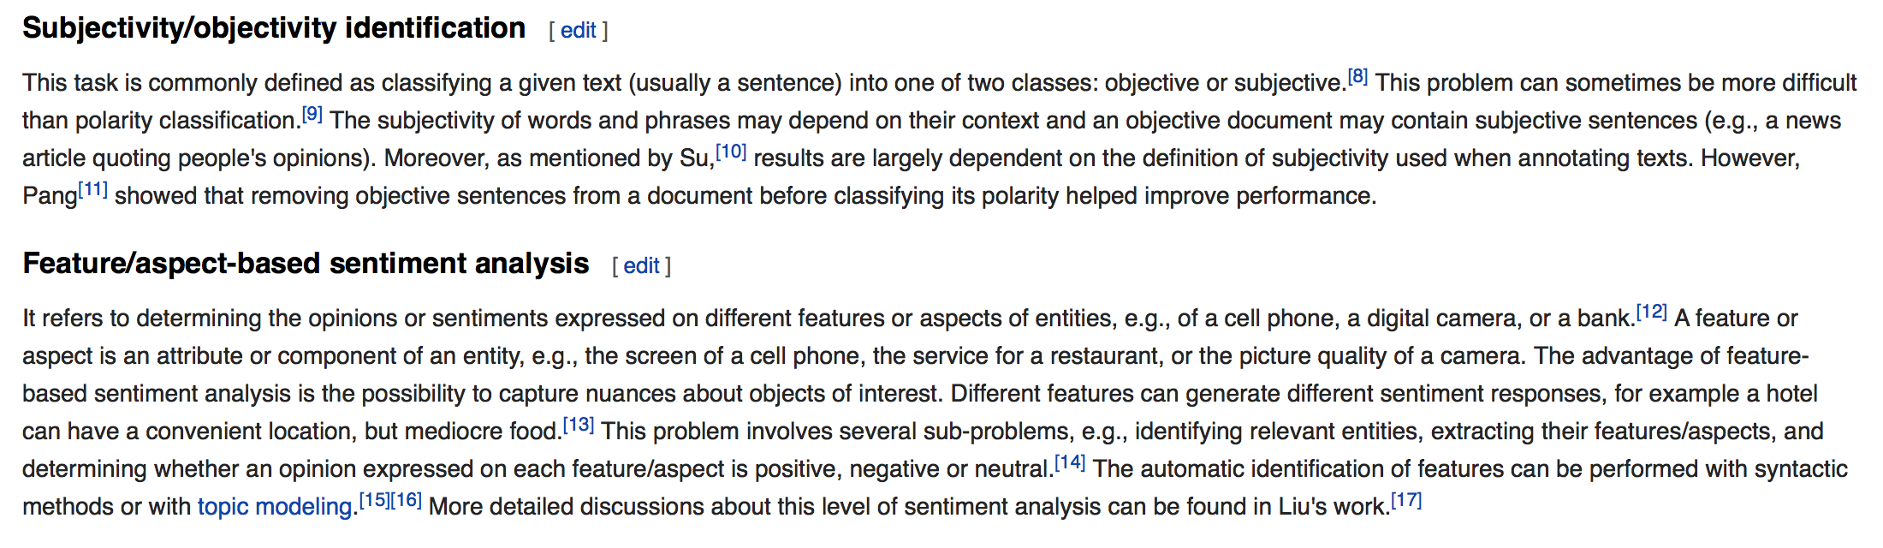
What is Sentiment Analysis?
Sentiment analysis is a function of the language used in a block of text
Given a text/sentence it provides two metrics (definitions from Wikipedia)
Polarity

Slide 21
How to Interpret Polarity Scores?
Polarity Score range [-1.0, 1.0]
Neutral Language
Positive
Language
0.0
-1.0
1.0
Negative
Language

Slide 22
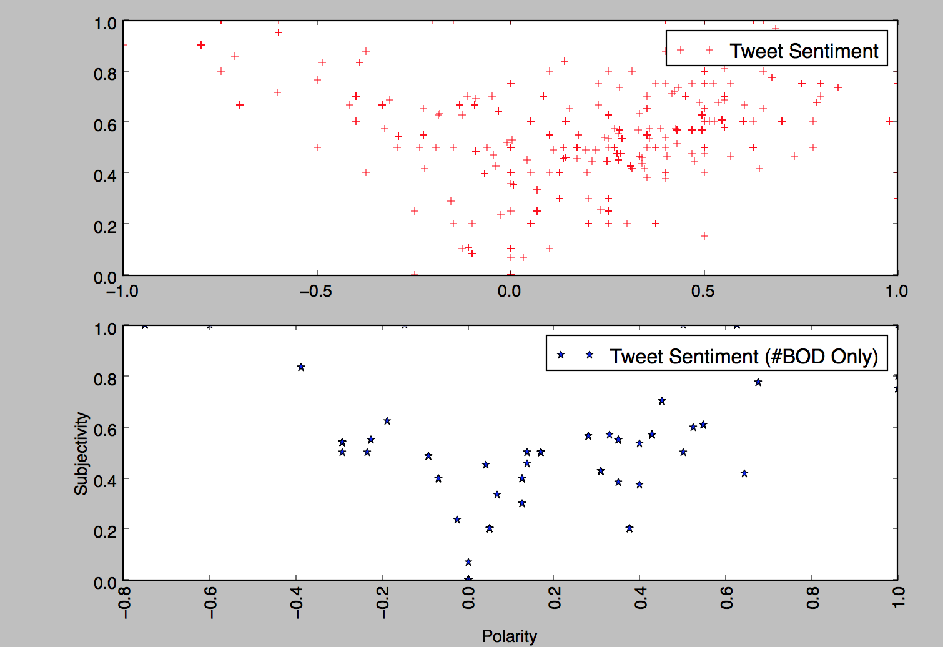
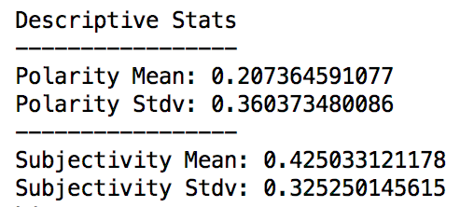
Sentiment Analysis on Tweets
Each dot represents a tweet or re-tweet
Focused on analyzing only the ones with negative polarity
In general, Polarity of the messages is positive. Quick reaction on negatives could turn around a user’s bad experience

Slide 23
Tweets with high Polarity (>=0.6)
“@P413_Life: @Beachbody @beachbodylive @PiYoWorkout @michelepark is awesome! I'm so grateful for her modified moves in PiYo!”
“@Fitness_Avenger My best friend @IDTheJC is a @Beachbody coach. He's the one who got me set up with it.”
“@Beachbody Honestly, I drone it to begin with because I have to get it done, and 5 minutes in, I'M PUMPED!”
“@Beachbody @BB_Performance performance has improved my endurance, has taken away my muscle sourness, I'm in love with the products!!”
“Love this! 3 Words, Man!! @21DayFix #21DFX @Beachbody https://t.co/ajtYBqtZDD”
‘This is the best thing that can happened to me!, thanks @shauntfitness @Beachbody #FlexFriday i feel AMAZING!!! https://t.co/rEhRLDCdrH”
“@BeachbodyUK absolutely love it! Why people think it's just for beginners is beyond me?! It's great for all abilities #P90 #rocks”
“@yamifitness25: Pretty happy with this!!! #fitnessmotivation #fitlife #fitfam #fitspo #fitness #fitinspiration #bod… https://t.co/m1immp8ddb”
“Did this today on #BOD absolutely loved it!! Can't wait for it to come out!! #hammerandchisel https://t.co/u4B4iMQ7Cr”
“So happy for the amazing customer service @Beachbody ! :)”
“@jmorin24 @21DayFix @Beachbody LOL love it”

Slide 24
Tweets with negative Polarity (< 0.0)
“@Beachbody im seriously about to cancel my order. ..im received two emails saying my shipment is delayed and now won't ship until the 16th!”
“Thanks @Beachbody for fucking up my order which is going to be late, not sending a tracking #, and for your staff being completely useless😊”
“I'm so disappointed @Beachbody ... Especially after being hung up on my customer service...”
“@Beachbody terrible, canceled an order over a month ago only to have it billed this month bc someone postponed it instead of canceling #fail”
“It's really frustrating when I wake up at 5am and my @beachbody on demand is not working from any device!!! Ugh!!!”
“@Beachbody Can you please help me with a faulty purchase I bought from your website...I've emailed so many times but nobody ever replies!”
“False Positive” - Example
“RT @Beachbody: Never let a bad playlist ruin a workout again. This Spotify channel has everything you need. https://t.co/dZUZrLuKxc https:/…”

Slide 25
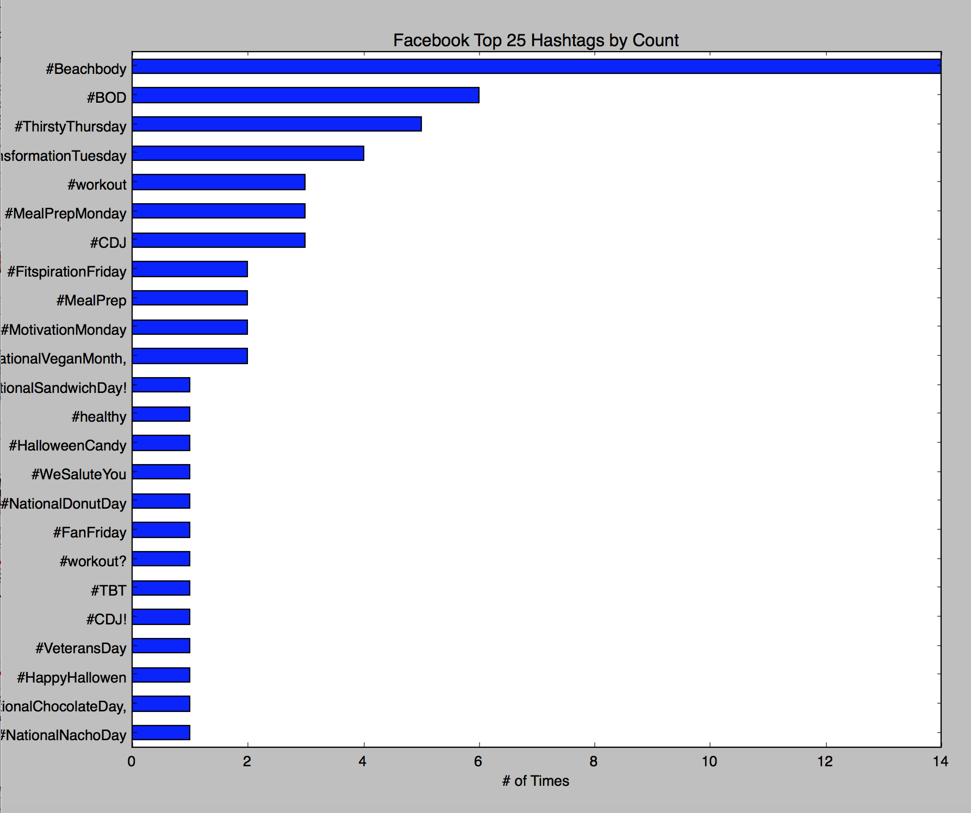
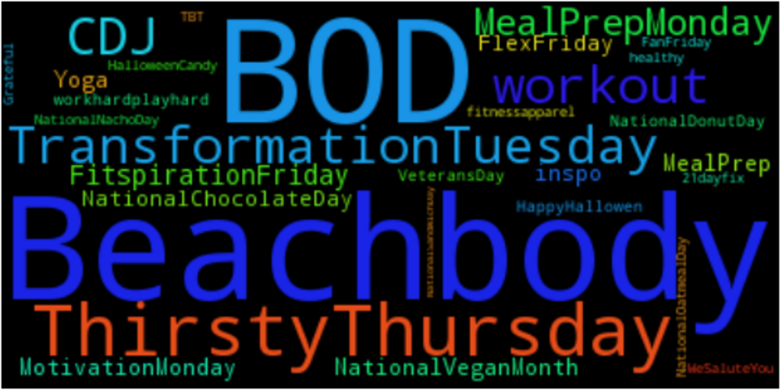
Facebook – Hashtag Analysis (11/1 to 11/24)
from 11/1 to 11/24
160 Comments on Facebook page
Facebook does not seem to be as used as Twitter for Beachbody’s users

Slide 26
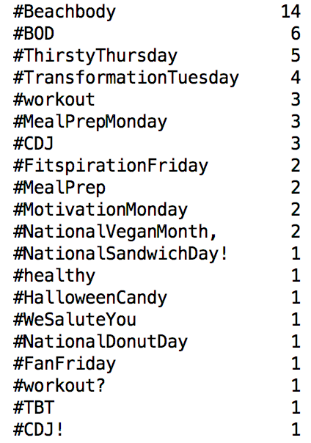
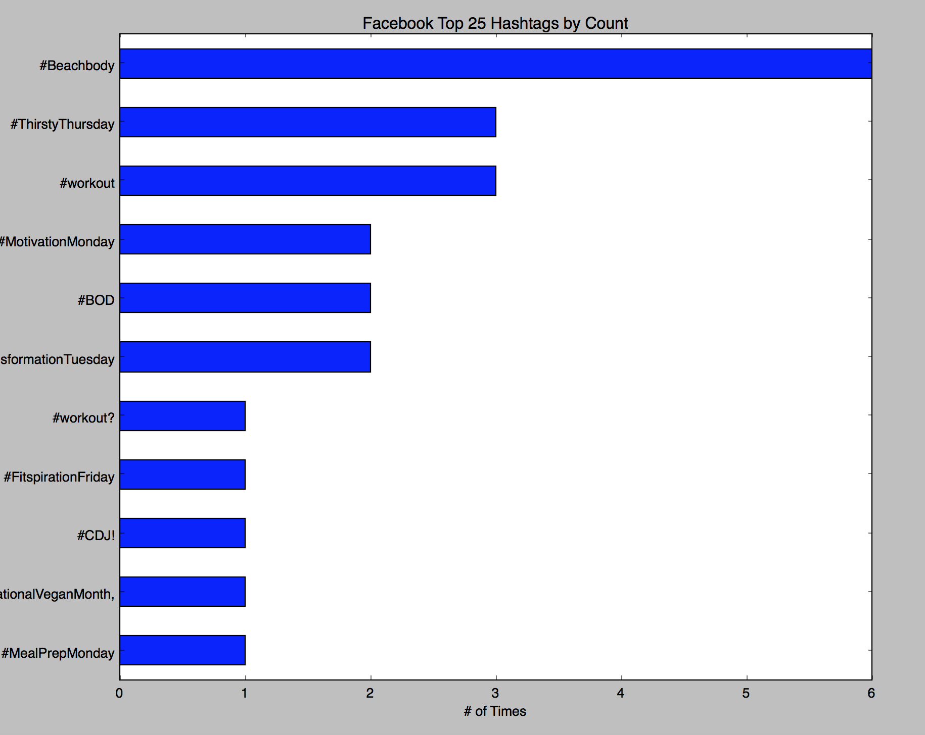
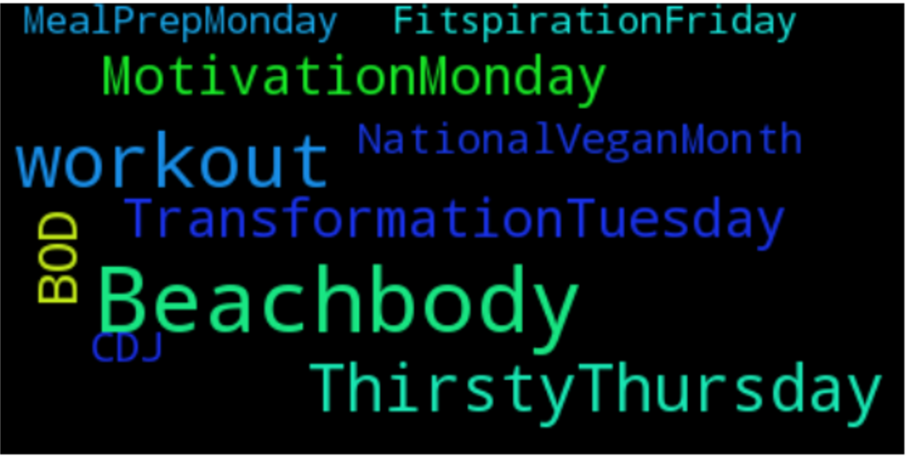
Facebook – Hashtag Analysis
(from 11/13 to 11/24)

Slide 27

How Social Listening Can Help Beachbody’s Brainstorming
Automatic “Service Case” creation in Customer Service Ticket Platform? (API or Streaming API)
Identification of Beachbody’s Social Media “brand champions”?
Understanding what people say about competitors?
Identification of competitor’s “brand champions”?
Map of “influencers” based on connections?
Analyze what type of tweets generate more “re-tweeting”? Food recipes? Exercise tips? Can we maximize Beachbody’s reach?
Others?

Slide 28
Additional Ideas
Descriptive
“Find” the group of activities/products that improve the chances of a customer to succeed
Provide “1-to-1” tips to customers based on their history and the “best practice” model
Customer Segmentation based on user pattern/purchase history
Cross-selling/Partnerships with other complementary products/brands (e.g. fitbit)
Predictive
Is customer success in the program at risk and define actions to support her/him (find patterns from not-succeeded customers)
Would a customer renew her/his subscription to BOD? (churn probability)
Given a campaign, what is the probability that a given customer will respond/accept/buy? (campaign design)

Slide 29

Thanks for your time!

Slide 30
Appendix

Slide 31
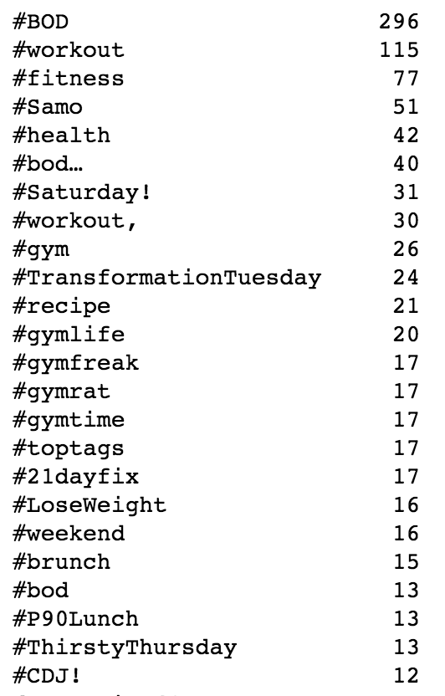
Top 25 most common hashtags associated with Beachbody over the course of 1 week

Slide 32
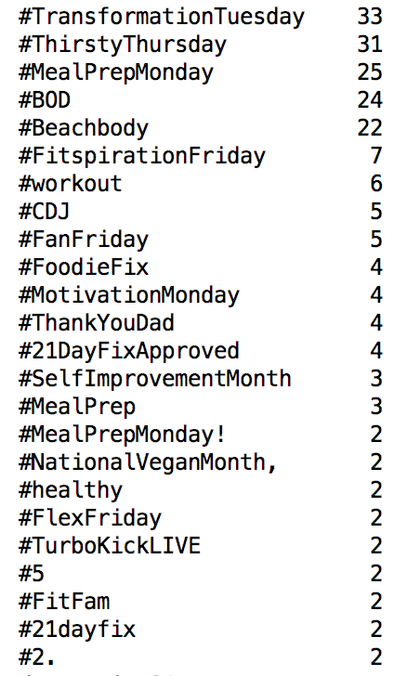
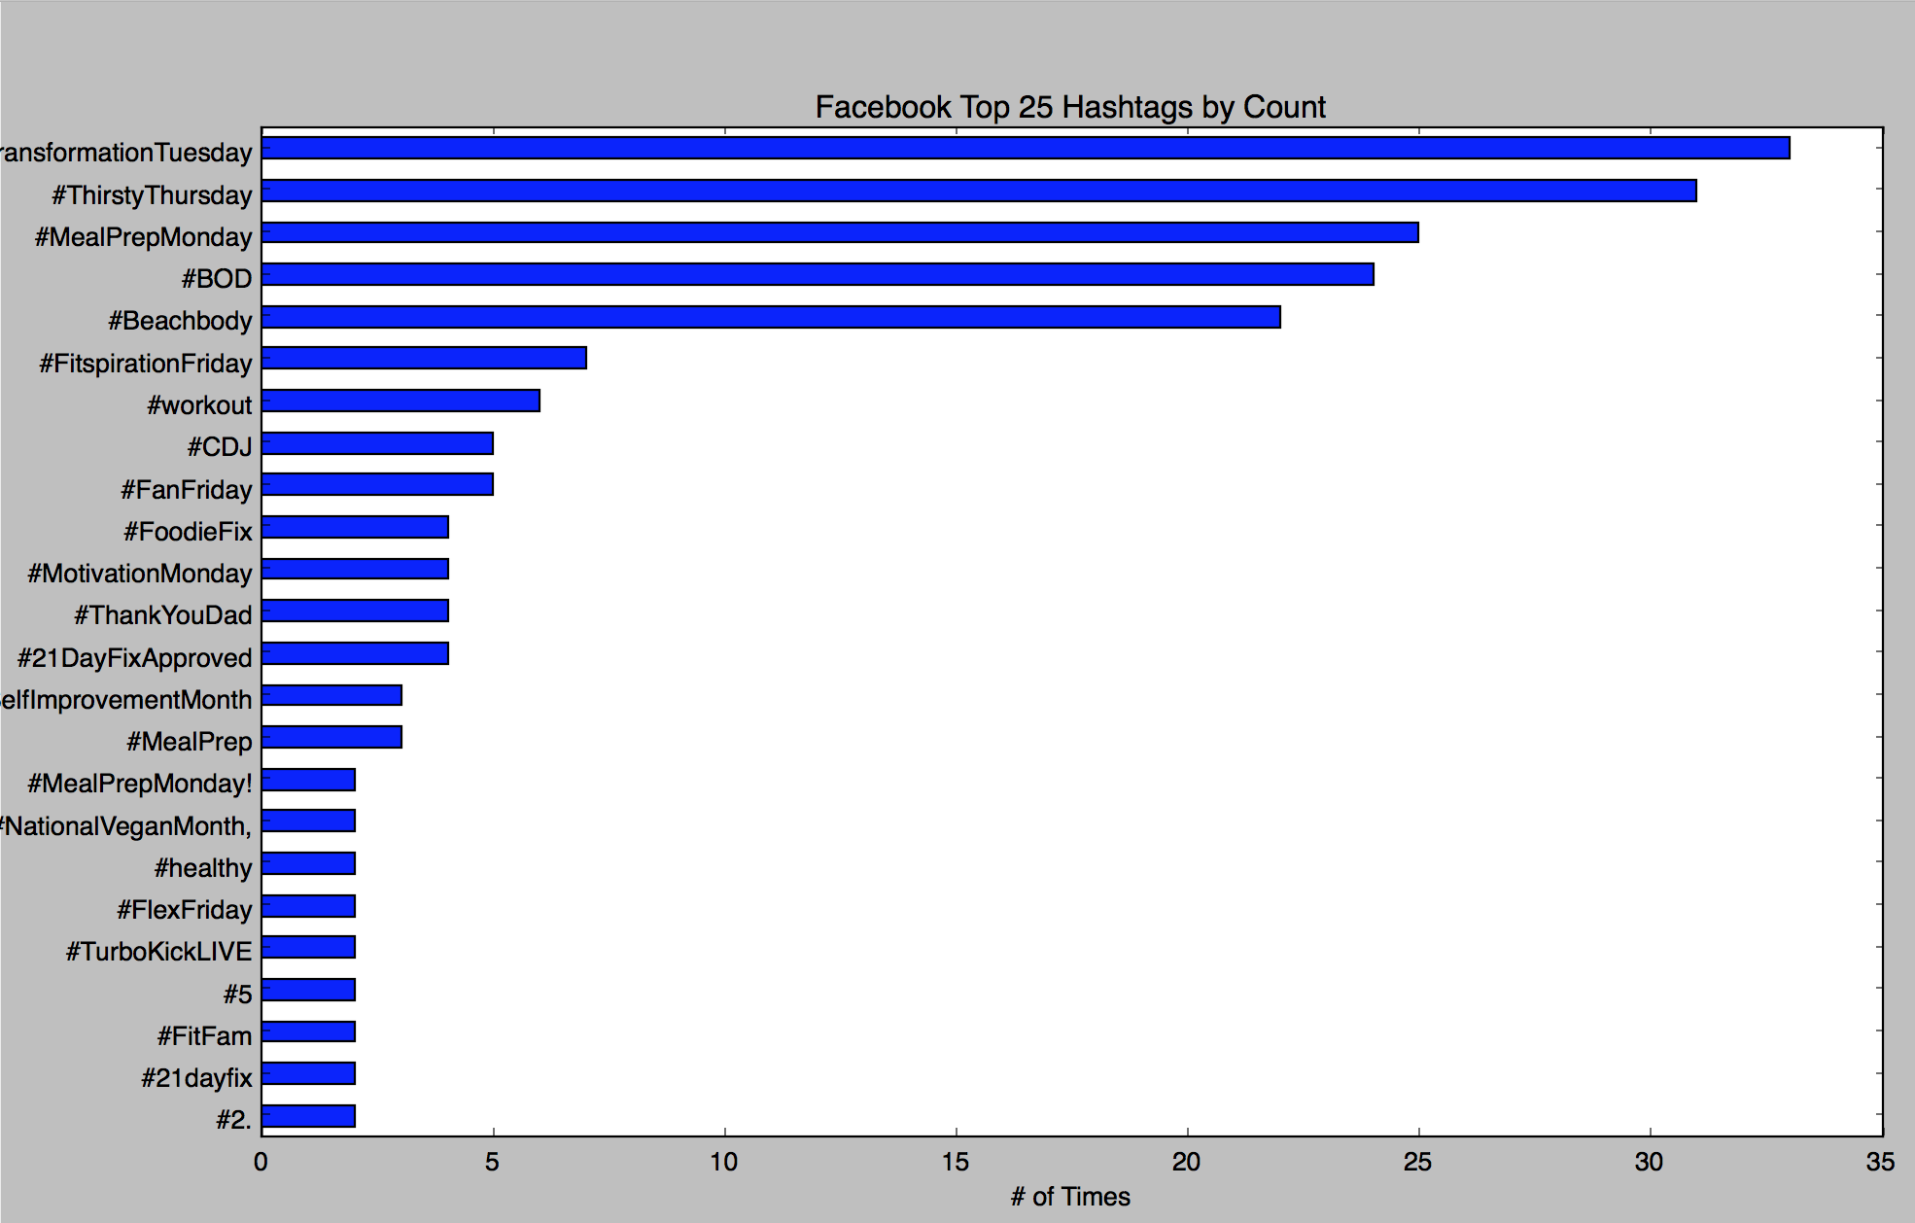
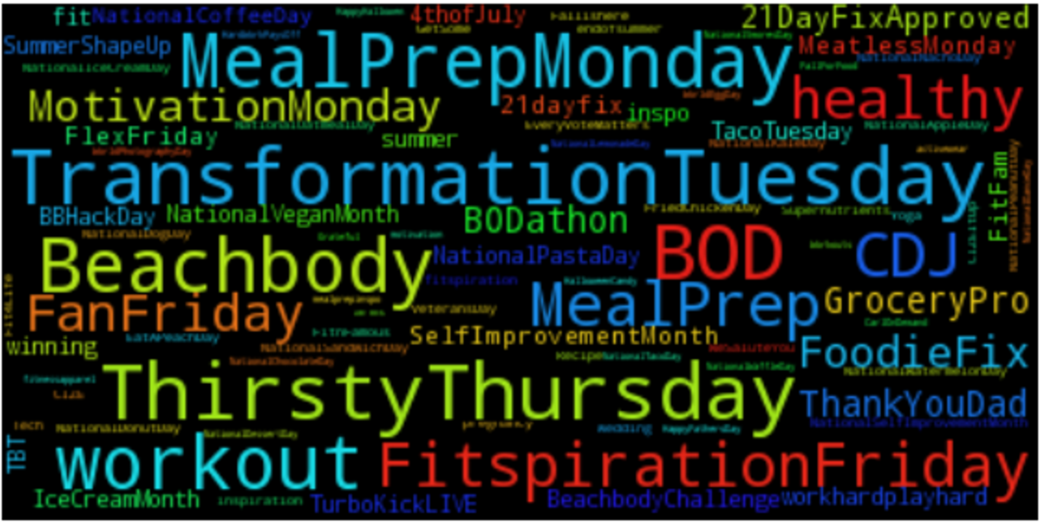
Facebook

